Slide 1
A guide for new-to-London student
Louise Huang 03.24.2021

Slide 2
Content
Introduction
Problem which tried to solve
Data & Methodology
Conclusion

Slide 3
Introduction
This project aims to provide a guide for new-to-London college students, especially international students, to explore better facilities around their campus. This guide could help them make smart and efficient decisions on deciding neighborhood our of all the districts in London, UK. The first part of the guide is specifically for UCL/LSE/KCL students as their campus is located in central London. By utilizing this guide, students could find best area to try exotic cuisine, find home food or seek that niche bookshop area full of cute cafes.

Slide 4
Problem which tried to solve
List and visualize Central London district with specific facilities
Which is the best neighborhood for you to find your home food when you get homesick?
Where would you go for an experience of theatre-going and book-shopping, aka art and cultural stuff?

Slide 5
Data used in this guide:
Foursquare API is used as the primary data source for this project. As a database of millions of places around the world, this project utilized Foursquare places API to provides location search, sharing and details.
List of London District Name and Post code is scrapped from Wikipedia. Latitude and the longitude coordinates of each district come from Geocoder package in Python.
After data cleaning and wrangling, I performed K-means clustering algorithm to segment neighborhoods for better understanding and solving our problems mentioned above.

Slide 6
Methodology:
Data retrieval, exploration and wrangling
Performing K-means clustering algorithm to segment neighborhoods

Slide 7
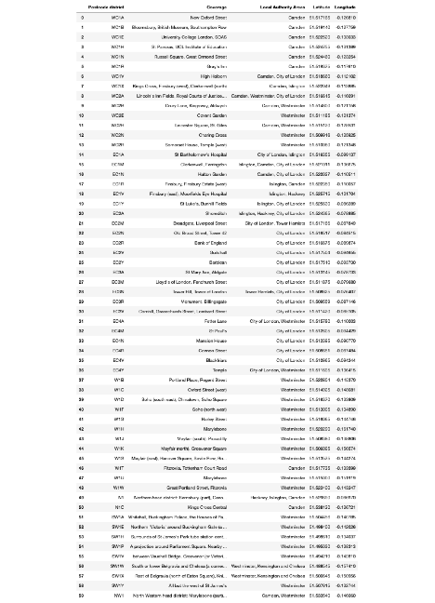
Data retrieval, exploration and wrangling
List of postal code and district name is scrapped from Wikipedia. Latitude and Longitude of each neighborhood is retrieved using Geocoder from Geopy Library of Python.

Slide 8
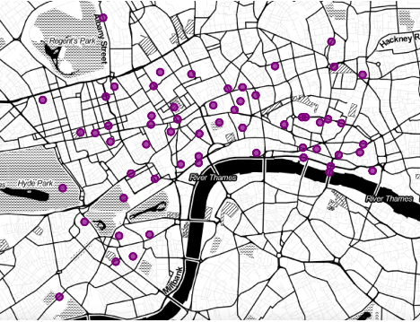
Use folium library to visualize the district in central London area

Slide 9
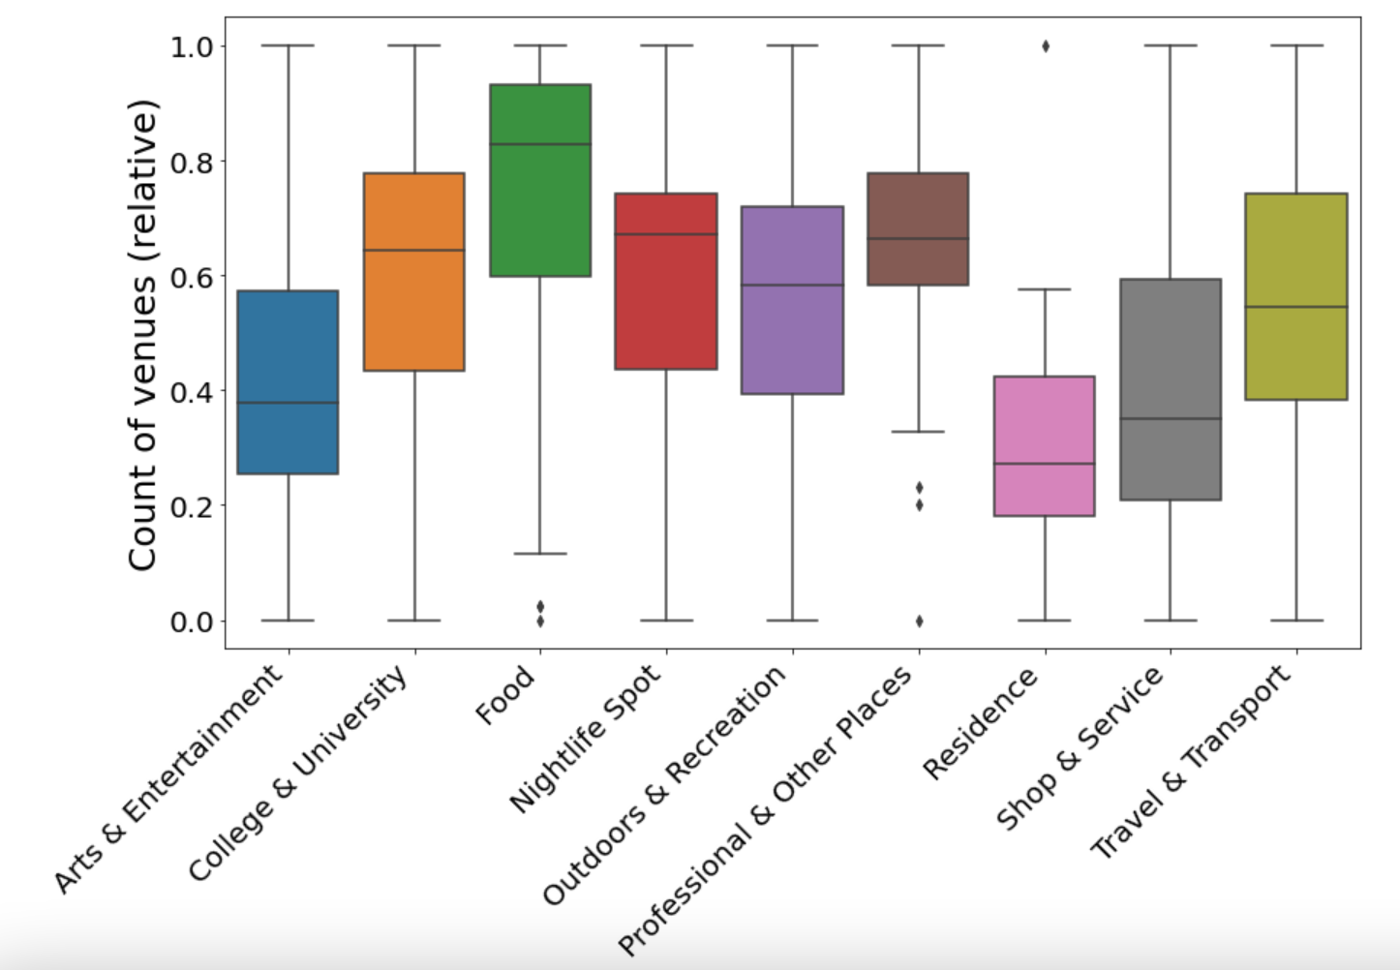
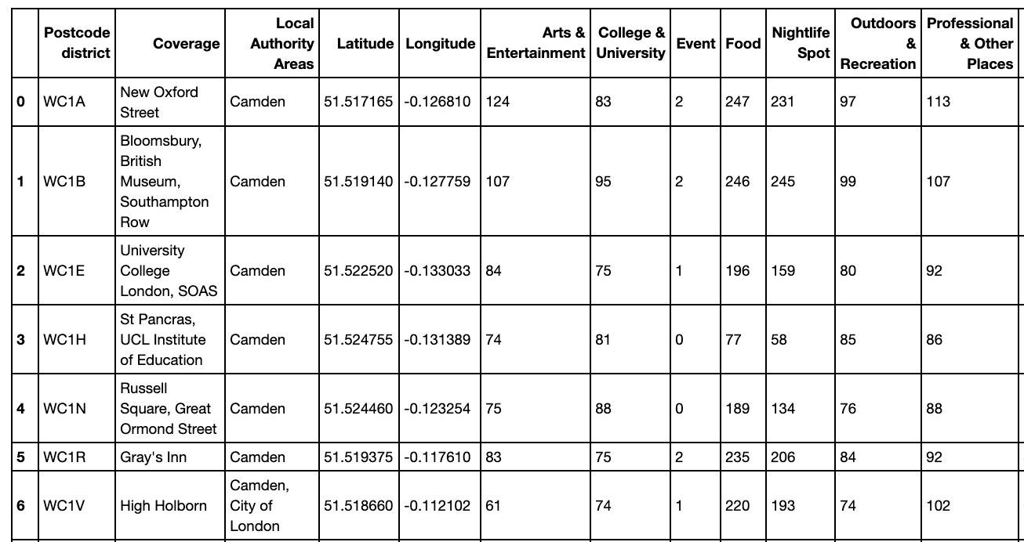
Foursquare API is used to explore types of venues in each area and 10 top level categories are identified:
Arts & Entertainment
College & University
Food
Nightlife Spot
Outdoors & Recreation
Professional & Other Places
Residence
Shop & Service
Travel & Transport

Slide 10
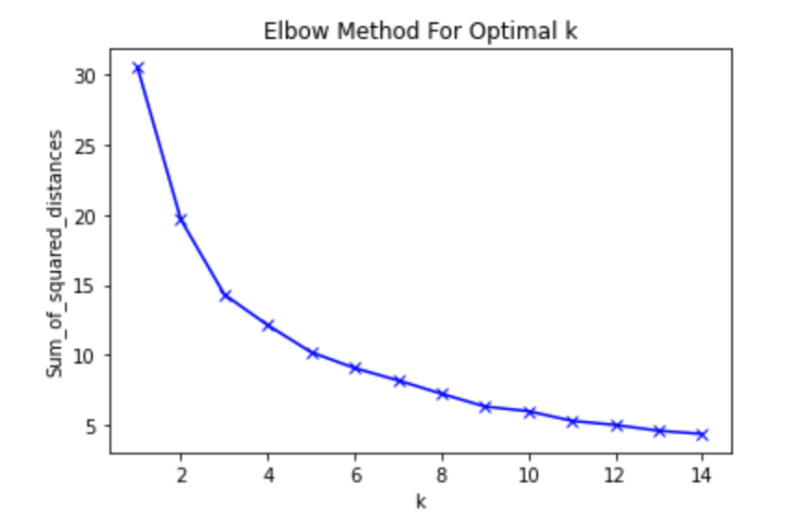
Performing K-means clustering algorithm to segment neighborhoods
1. Determine the optimal number of clusters

Slide 11
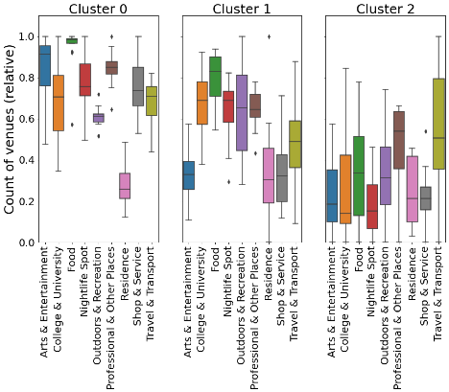
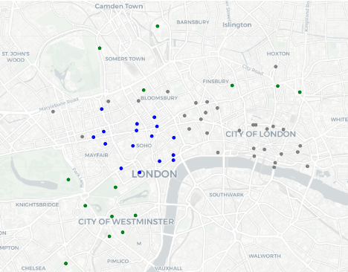

Slide 12
Conclusion:
Combine the Box Plot and the map, we could see that Cluster 0 Blue points) apparently has more fun and entertainment places that are full of restaurants, cute shops and theatres. Cluster 1 Grey points) has less shops but more companies. Cluster 3 (green points) has less fun stuff but acting more as the transportation center in London.

